Slide 1
Credit Card Fraud Detection
Data Source: https://www.kaggle.com/mlg-ulb/creditcardfraud

Slide 2
The transaction amount is relatively small. The mean of all the mounts made is approximately USD 88.
Most of the transactions were Non-Fraud (99.83%) of the time,
while Fraud transactions occurs (0.17%) of the time in the data frame.

Slide 3
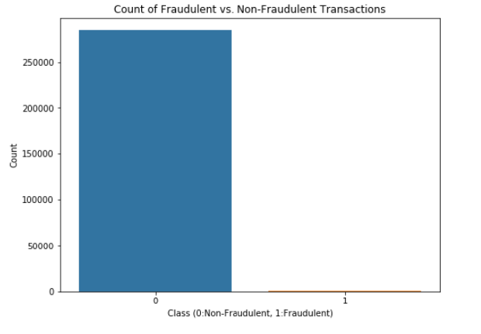

Slide 4
We will first scale the columns comprise of Time and Amount . Time and amount should be scaled as the other columns. On the other hand, we need to also create a sub sample of the data frame in order to have an equal amount of Fraud and Non-Fraud cases, helping our algorithms better understand patterns that determines whether a transaction is a fraud or not.
Correlation matrices are the essence of understanding our data. We want to know if there are features that influence heavily in whether a specific transaction is a fraud.
Negative Correlations: V17, V14, V12 and V10 are negatively correlated. Notice how the lower these values are, the more likely the end result will be a fraud transaction.
Positive Correlations: V2, V4, V11, and V19 are positively correlated. Notice how the higher these values are, the more likely the end result will be a fraud transaction.

Slide 5
Interquartile Range (IQR): We calculate this by the difference between the 75th percentile and 25th percentile. Our aim is to create a threshold beyond the 75th and 25th percentile that in case some instance pass this threshold the instance will be deleted.
The lower the threshold the more outliers it will remove however, we want to focus more on "extreme outliers" rather than just outliers. Why? because we might run the risk of information loss which will cause our models to have a lower accuracy. You can play with this threshold and see how it affects the accuracy of our classification models.
Visualize Distributions: We first start by visualizing the distribution of the feature we are going to use to eliminate some of the outliers. V14 is the only feature that has a Gaussian distribution compared to features V12 and V10.
Determining the threshold: After we decide which number we will use to multiply with the iqr (the lower more outliers removed), we will proceed in determining the upper and lower thresholds by substrating q25 - threshold (lower extreme threshold) and adding q75 + threshold (upper extreme threshold).
Conditional Dropping: Lastly, we create a conditional dropping stating that if the "threshold" is exceeded in both extremes, the instances will be removed.

Slide 6
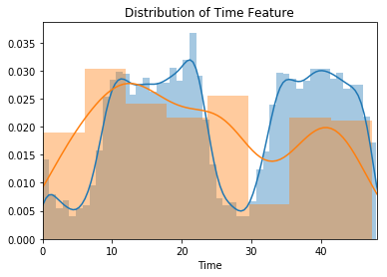
We convert the time to hours in order to understand when the number of frauds are increased. If we accept that the number of transactions are increased at daytime and decrease at nighttime, the percantage of frauds are increased at nighttime.

Slide 7
Data Quality
There is no missing value in the data.
There are no duplicates or measurement errors.
We didn’t do any feature engineering as our data is mostly undergone PCA transformation and the rest of features is good enough.

Slide 8
Data Preparation
-We need to scale our time and amount features because otherwise, it would result much worse in certain algorithms such as Logistic regression.
Creating a Training Set for a Heavily Imbalanced Data Set
-Our data set is imbalanced as we mentioned previously. There are certain methods to handle this problem such as Random over-sampling, Cluster-based over-sampling, Synthetic over-sampling, Modified Synthetic over-sampling, Random under-sampling. We need to look the performance of the each method.
- We are going to utilize random under-sampling to create a training dataset with a balanced class distribution that will force the algorithms to detect fraudulent transactions as such to achieve high performance. We are not going to rely on accuracy. Instead, we are going to use the Receiver Operating Characteristics-Area Under the Curve or ROC-AUC performance measure.

Slide 9
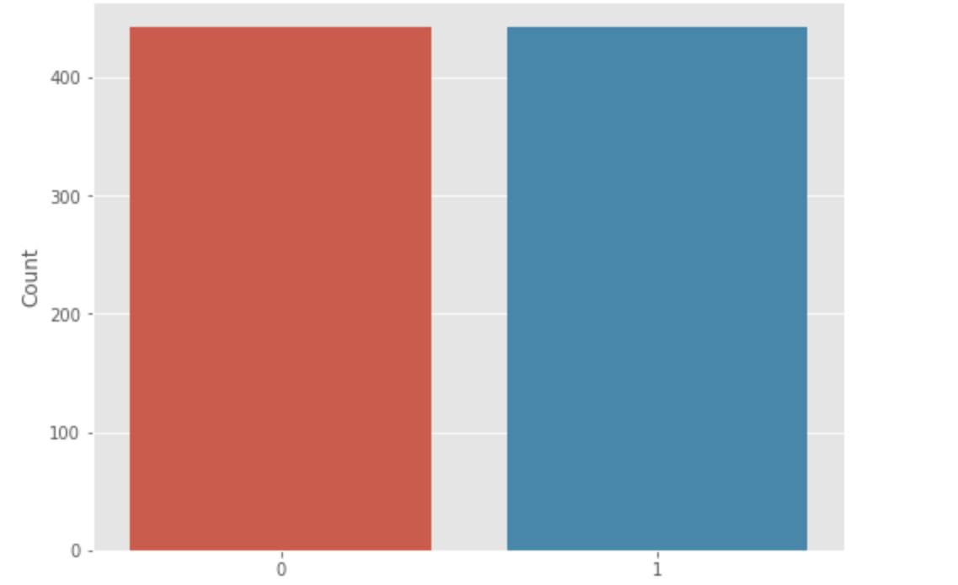
Sub-sample
After under-sampling, our sub-sample will look like this.
Additionally, outlier detection and removal could be applicable in our algorithm. Loss of data and precision trade-off should be well balanced in this case.
Fraudulent
Non-Fraudulent

Slide 10
Algorithm
In order to see which algorithm would perform best on our data, we searched similar algorithms that solves similar problems.
We decided to use Logistic regression and/or Random forest depending on accuracy. If we want to reach higher degree of comprehensiveness while only slightly decreasing performance, we will also apply Random forest.
We will perform an 80/20 train-test split and in order to avoid overfitting, we will use the very common resampling technique of k-fold cross-validation.

